Slide 1


Session 8
Python Syntax - 1
TUPLE AND DICTIONARY

Slide 2
Learning Outcomes
Tuples
Built-in Tuple Methods
Dictionary
Built-in Dictionary Methods
Sets
Built-in Set Methods

Slide 3
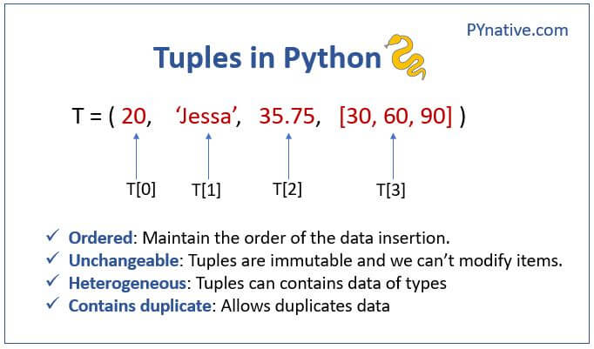
Introduction to Tuples

Slide 4
Tuples are constructed with brackets ( ) and commas separating every element in the tuple.
# Assign a tuple to a variable named my_tup my_tup = (1,2,3) print(my_tup)
(1, 2, 3)
NOTE: Tuples are similar to lists in every aspect except for the fact that tuples are immutable while lists are mutable.
We just created a tuple of integers, but tuples can hold different object types. They can also hold duplicate elements just like lists, For example,
my_tup = ('A string',23,100.232, 'o') print(my_tup)
('A string', 23, 100.232, 'o')
# Check len just like a list my_tup = (1,2,3) len(my_tup)
3

Slide 5
Tuple indexing and slicing also work similarly to list and string slicing
# Use indexing just like we did in lists my_tup[0]
1
# Slicing just like a list my_tup[-1]
3
It can't be stressed enough that tuples are immutable. This means we cannot do individual item assignments on them
my_tup[0]= 'change'
It will throw an error
--------------------------------------------------------------------------- TypeError Traceback (most recent call last) <ipython-input-10-378d31028a15> in <module> ----> 1 my_tup[0]= 'change' TypeError: 'tuple' object does not support item assignment

Slide 6
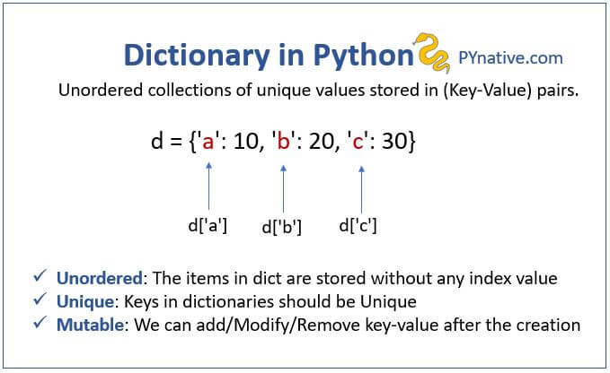
Introduction to Dictionary

Slide 7
Dictionaries are constructed with brackets { } and commas separating every pair in the Dictionary and: separating every key and value
# Make a dictionary with {} and: to signify a key and a value my_dict = {'key1':'value1', 'key2':'value2'}
A key and value pair encompasses one element inside a dictionary
# Call values by their key my_dict['key2']
'value2'
Values of the dictionary elements can be any datatype (list, strings, int, float, etc)
my_dict = {'key1':123, 'key2':[12,23,33], 'key3':['item0', 'item1','item2']}
The keys can only have datatype int, float, and string.
my_dict = {1:123,1.1:[12,23,33],' a':['item0', 'item1', 'item2']}

Slide 8
pop()
The pop() method removes the specified item from the dictionary. The value of the removed item is the return value of the pop() method, see the example below.
car = {"brand": "Ford", "model": "Mustang", "year": 1964} x = car.pop("model") print(x)
Mustang

Slide 9
Built-in Dictionary methods
There are a few methods we can call a dictionary. Let's get a quick introduction to a few of them:
# Create a typical dictionary d = {'key1':1,'key2':2,'key3':3}
# Method to return a list of all keys d.keys()
dict_keys(['key1', 'key2', 'key3'])
# Method to grab all values d.values()
dict_values([1, 2, 3])
# Method to return tuples of all items (we'll learn about tuples soon) d.items()
dict_items([('key1', 1), ('key2', 2), ('key3', 3)])

Slide 10
Iterating over dictionary
We can use for loop to iterate over dictionary elements
my_dict = {'key1':'value1', 'key2':'value2', 'key3':'value3', 'key4':'value4'} for i in my_dict: print(i)
key1 key2 key3 key4
Iterating over the dictionary only gives out the keys and not the corresponding values. We can use the methods discussed above to access the values of both the keys and values together from a dictionary
using the values() method to iterate over values
my_dict = {'key1':'value1', 'key2':'value2', 'key3':'value3', 'key4':'value4'} for i in my_dict.values(): print(i)
value1 value2 value3

Slide 11
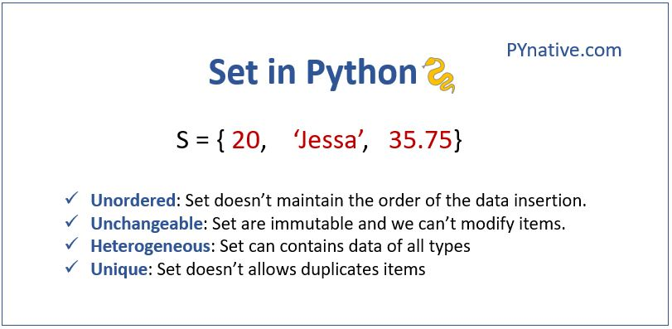
Introduction to Sets

Slide 12
Sets are constructed with brackets { } and commas separating every element in the tuple.
In Python, a Set is an unordered collection of data items that are unique. In other words, Python Set is a collection of elements (Or objects) that contains no duplicate elements.
# Assign a set to a variable named my_set
my_set = (5,10,20) print(my_set)
(5, 20, 10)
set using {}
# set of the mixed types integer, string, and floats
set1 = {'Mark', 'Jessa', 25, 75.25}
print(set1)
Output {25, 'Mark', 75.25, 'Jessa'}

Slide 13
Built-in Set methods
add( ) build-in method adds element x to the set.
my_set = {1, 2, 3}
my_set.add(4)
print(my_set) # Output: {1, 2, 3, 4}
remove( ) to remove a single item from a set.
my_set = {1, 2, 3}
my_set.remove(2)
print(my_set) # Output: {1, 3}

Slide 14
HOMEWORK
Task 1.Access value 20 from the given tuple.
tuple1 = ("Orange", [10, 20, 30], (5, 15, 25)) (Hint: use indexing)
Task 2.Write a Python program to iterate over dictionaries using loops for the given dictionary.

Slide 15
HOMEWORK SOLUTION
#TASK 1: Access value 20 from the given tuple.
tuple1 = ("Orange", [10, 20, 30], (5, 15, 25)) (Hint: use indexing)
tuple1 = ("Orange", [10, 20, 30], (5, 15, 25))
# understand indexing
# tuple1[0] = 'Orange'
# tuple1[1] = [10, 20, 30]
# list1[1][1] = 20
print(tuple1[1][1])
20
HOMEWORK SOLUTION
#TASK 2
d = {'x': 10, 'y': 20, 'z': 30}
d = {'x': 10, 'y': 20, 'z': 30}
for dict_key, dict_value in d.items():
print(dict_key,'->',dict_value)
x -> 10
y -> 20
z -> 30

Slide 16
#TASK 3 Reverse the tuple(Hint: use slicing)
#TASK 4 Count the number of occurrences of item 50 from the given tuple. tuple1 = (50, 10, 60, 70, 50)
#TASK 5 Write a Python script to print a dictionary where the keys are numbers between 1 and 15 (both included) and the values are squares of keys
#TASK 6 Create a tuple with a single item 80
#TASK 7 Create a dictionary by extracting the keys from the given dictionary.
sampleDict = {"name": "Kelly", "age":25, "salary": 8000, "city": "New York" }
my_dict = {'name':'Kelly','age':'25','salary':'8000','city':'New York'}

Slide 17
THANK - YOU

